Slide 1









Predictive Modeling for High School Student Interest Trends
Brandon Mather
Notes:
note

Slide 2

Introduction
This presentation will give an insight into the interests of high school students based on data collected from social media.
This information will help give valuable information for people in education, social media, and youth-focused industries.

Slide 3

Problem
Marketing and educational institutions are very interested in understanding the interests of high school students.
Gathering data on student interests can be challenging. With the use of predictive modeling this could be simplified and streamlined to help predict future interests.
This information can help with targeted marketing, curriculum developments, and engagement.

Slide 4

Data
The dataset that was used was a random sample of 15,000 high school students from social media during the years 2006 to 2009.
This data includes demographic information such as graduation year, gender, and age as well as the number of friends each has.
It also includes interest-related data, the counts of the 37 most common words found in the profiles.
All data was collected using text mining.

Slide 5
Methods
Data Preprocessing
EDA
Modeling
Used to make sure data is usable and can offer insights into trends.
Exploratory Data Analysis: reveals insights into the data.
Predictive modeling is used to forecast future trends in students.

Slide 6
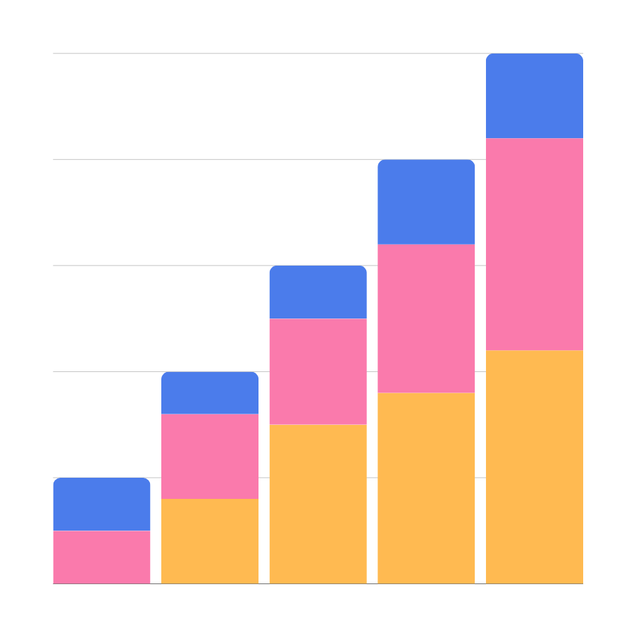
Analysis

Slide 7
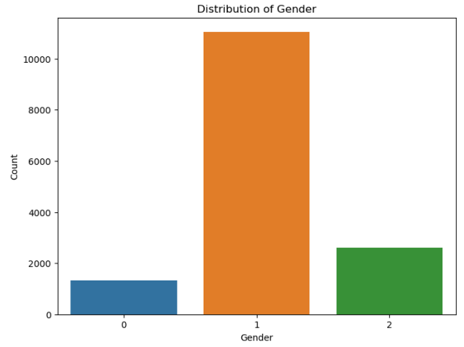
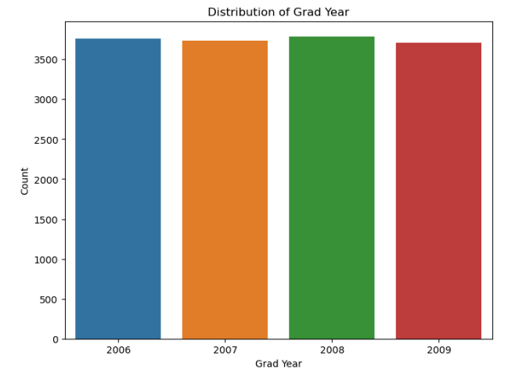
Demographic Information

Slide 8
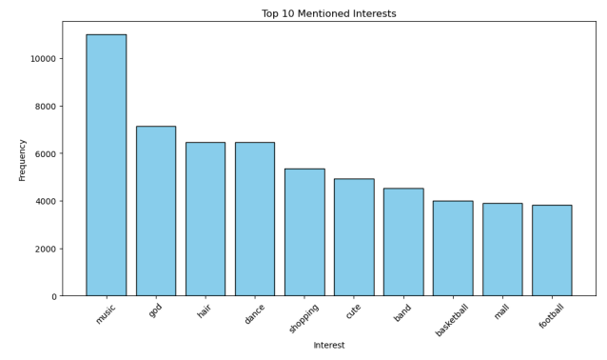
Top 10 Interests

Slide 9
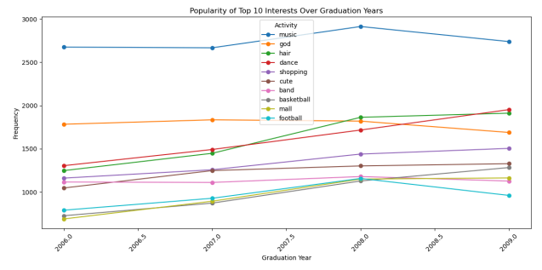
Top 10 Interests Over Time

Slide 10
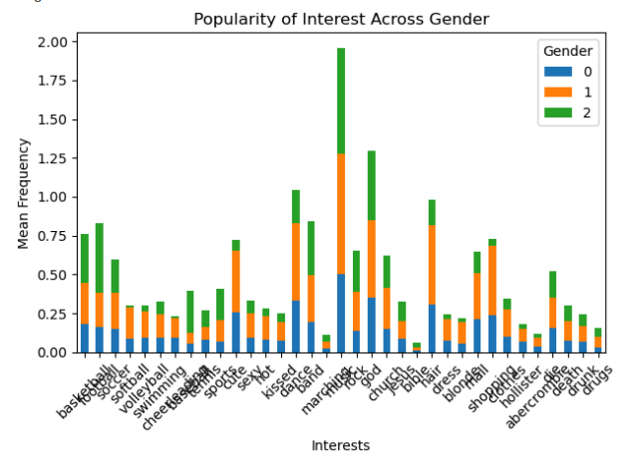
Popularity Of Interests Across Genders
0 = No gender specified
1 = Female
2 = Male

Slide 11
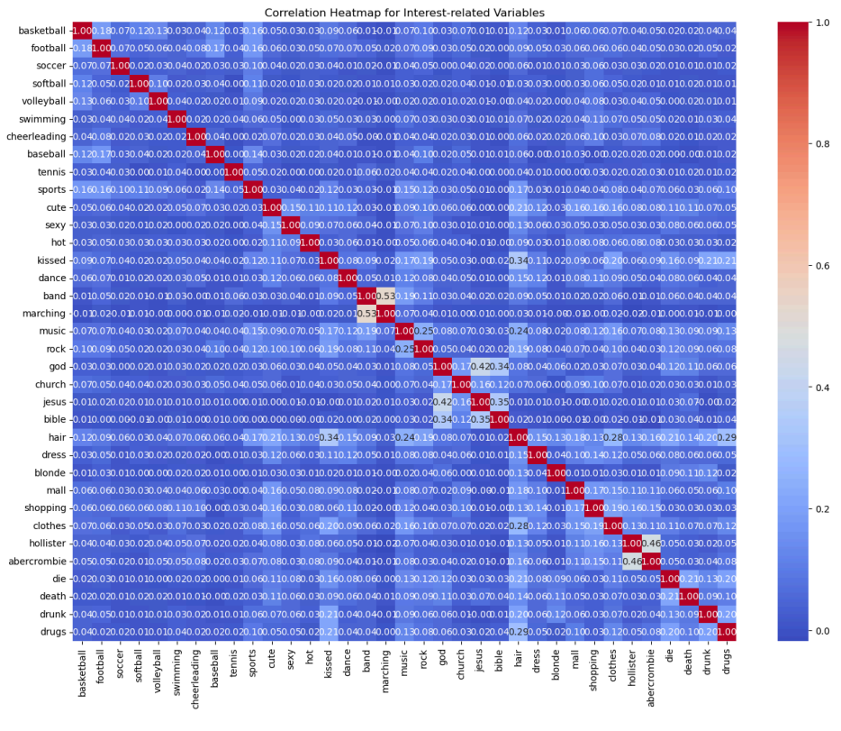
Correlation Among Interests

Slide 12
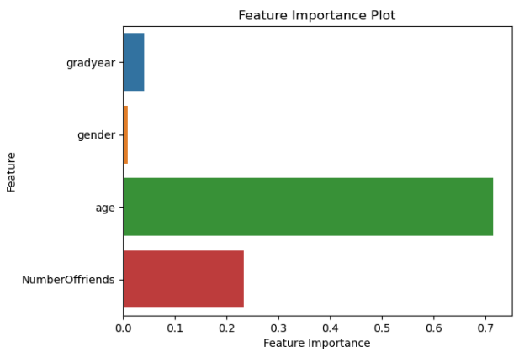
Modeling
Created a Predictive Model that would be able to predict the interests of each individual demographic.\
Demographics that are most important in the model are age and the number of friends they have.

Slide 13


Conclusion
This analysis sheds light on the online interests of high school students.
The model will be able to make predications on which interests relate to each individual demographic.
By understanding these trends, we will be able to make high school student lives better in the digital space.
Future research could continue to explore trends in high school students interests to help with marketing research, customer segmentation and personalized recommendations.

Slide 14
Thank you!

